Slide 1
There has been a lot of concern about “toilet-to-tap”. I would just like to explain what the process actually involves and why it is being considered. It is the optics of this that are going to be so determinate of people’s vote. People hear the phrase “toilet-to-tap” & it just sounds intrinsically bad to anyone - of course we do not want toilet to tap.

Slide 2
To start off
Potable water = drinking water

Slide 3
Some Wastewater Definitions
Typical domestic wastewater sewer systems do not differentiate between types of domestic wastewater which is a mix of gray water and blackwater
Graywater is water from bath, laundry, and sinks other than kitchen
Blackwater is domestic sewage and kitchen drains

Slide 4
Again Black water re-use is what is referred to as 'toilet to tap'
The reason it is being considered is because of low aquifer levels
Per the US Drought monitor - the majority of Fl is in an ‘extreme drought’
Options to address this problem would be reusing surface water, reusing blackwater, desalination, or using less water.
Regarding water use: 60% goes to public use (households & their yards), 18% to agriculture, 8% to commercial/industrial, 6% to domestic self-supply/small public supply systems (wells to residences or campgrounds etc.), 5% to public landscapes and recreational, 3% to power generation
Population increased 38% from 2004 to 2023 in the St John’s Water Management District which includes volusia county

Slide 5
ASR Wells
ASR stands for Aquifer Storage and Recovery
Groundwater recharge = injecting to aquifers via ASR Wells
Prior to injection into ASR wells, the water must be treated to meet Fl’s primary and secondary drinking water quality standards
The level of treatment after withdrawing from the ASR depends on the use of the water
Before introduction into a public water supply treatment facility the water is treated to meet standards requiring water be safe for human consumption
2032 is the goal year when reused water would be cleaned and available as drinking water
ASR Wells have been used throughout the US and in FL for nearly 40 years, there are over thirty operational ASR Systems in FL. ASR Wells can use a variety of sources, such as surface water, graywater, blackwater, etc. So ASR Well use does not necessarily mean re-use blackwater.

Slide 6
ASR Wells in Volusia County
Currently there are no operational ASR Systems in Volusia county
4 wells were permitted in the past: 1 in Daytona, 1 in Deland, 1 in Ormond, 1 in NSB
The Daytona Beach test/exploratory ASR Well was constructed but never tested
The ASR well in Deland went through testing but was never operational
There have been permits issued for two injection wells in Deltona however neither have been constructed and neither are permitted for injection of treated waste water.

Slide 7
The Potential Deltona Wells
Funding for one of the wells has not been obtained. For the well which has obtained funding, construction has not been initiated; this well aims to re-inject treated surface water into the aquifer.
For this well which has obtained funding - attempts are being made at permitting prior to construction, to allow the well to enter the testing period, because of course you do not want to build something you will not be allowed to test.
Obtained construction funding is a 50/50 share between the state and the city of Deltona.
This well proposes to use surface water from Lake Monroe.
Wastewater is not permitted to use during the testing phase and high level disinfection criteria have to be met before reclaimed water is released to storage or reclaimed water use system.

Slide 8
Advantages of ASR Wells
The Advantage of ASR wells are that it eliminates the need to acquire large areas of land for surface reservoirs which are vulnerable to tidal influences and substantial evaporative losses

Slide 9
Some of the mandatory safety and treatment precautions
When a proposal for use of an ASR Well is made, it is mandated there can be no more than 5mg/L of total suspended solids before application of disinfectant
For context, surface water typically has 1000mg/L total suspended solids
The Nitrogen content cannot be greater than 10mg/L

Slide 10
More important definitions
Direct potable reuse is the delivery of advanced treated water from an advanced treatment water facility to a drinking water facility or directly into a potable water supply distribution system
This type of potable reuse does not include an environmental buffer
Indirect potable reuse is where highly treated wastewater is intentionally introduced into an environmental buffer - such as a groundwater aquifer - before being withdrawn, further treated if needed, and supplied as drinking water

Slide 11
ASR Wells are an example of indirect potable reuse
This is important for storage as it supplements the aquifers
It is important to have a large storage of drinking water

Slide 12
Another example of indirect potable reuse besides ASR Well injection into aquifers is surface water augmentation
Where discharges of reclaimed water or advanced treated water to surface water may be permitted when there is a need to supplement potable water sources.
Reclaimed water (also called recycled or reused water) is treated wastewater.
Advanced treated water is even higher levels of purification using reverse osmosis, UV Disinfection, advanced oxidation and other processes to remove pathogens, chemicals, and contaminants to near-drinking-water quality.
In this method reclaimed or advanced treated water is intentionally released into a natural surface body like a river, lake or reservoir rather than directly into pipes or a treatment plant. It requires rigorous monitoring, treatment standards and public health protections.
Water scarcity or supply issues is typically what triggers this permitting. If a region faces shortages due to drought, or population growth, this type of indirect potable reuse can boost the volume of surface water body. It is indirect potable reuse because there is an environmental buffer - the surface water body between the discharge point and the drinking water intake unlike direct potable reuse where treated wastewater goes straight into the supply system without a buffer. Indirect potable reuse like this and ASR Wells addresses water scarcity sustainably by turning wastewater into a reliable local resource instead of discharging it to the ocean or elsewhere.

Slide 13
To review some Safety Standards for the Reuse of Blackwater,
The water is mandated to reliably achieve a 12 log reduction in Giardia lambia cysts and cryptosporidium
For context, typically water standards include only a 4-5 log reduction
A 12 log reduction is 12 9s: 99.9999999999% reduction
I.e. A 4 log reduction is 99.99% reduction
So A 12 log reduction in giardia lambia cysts means a 1 in a trillion elimination rate, so if there was a vial of a trillion giardia lambia cysts, after treatment there could only be one left

Slide 14
To review Virus Reduction Standards,
The standard for rotavirus and norovirus is even more stringent, requiring a 14 log reduction or a 1/10 trillion elimination rate - more stringent than bottled water which is a required 4 log reduction.
95% of daily measurements/month have to meet or exceed these log inactivation disinfection requirements before it is injected into the aquifer
Requirements for re-use blackwater include that the risk of acute gastroenteritis from drinking the water must be less than 1/10,000 annually which is the benchmark standard for drinking water in the United States achieved with a 4-log reduction.

Slide 15
There must be Critical Pathogen Reduction Points in an ASR System
There must be a minimum of 3 separate critical points for pathogen reduction including one disinfection control point and one filtration control point
Design criteria have to address hazard identification, risk assessment, and the identification of at least two treatment barriers in addition to the comprehensive pretreatment and pollutant source control program
Secondary containment must be provided so that chemicals from equipment failure, spillage, or accidental drainage shall not enter the water in conduits, treatment, or storage basins unless they are double walled pipes, tanks, or containers.

Slide 16
In planning, Log Reduction Credits are used,
Log reduction credits are used during the planning period to determine if standards will be met in the future facility and during planned testing
During the application process to enter testing phase an applicant must propose values for log reduction value credits in it's engineering report based on engineering analysis, pilot studies, and available research
When you are engineering a plan, you have to have Systems planned that add up to the 12/14 log reduction, then once in testing, these amounts can be measured

Slide 17
To review Treatment Technologies,
Membrane filtration systems, including microfiltration, ultrafiltration, nanofiltration, reverse osmosis, or alternative membrane technologies are some options to achieve the desired log reduction value
UV Systems and oxidative systems will also be used to achieve a 12/14 log reduction

Slide 18
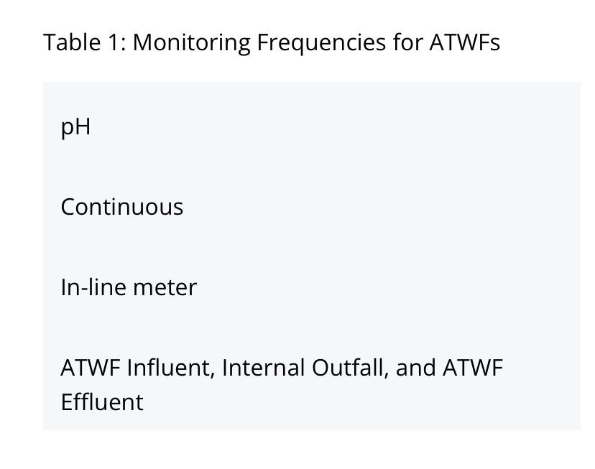

Slide 19
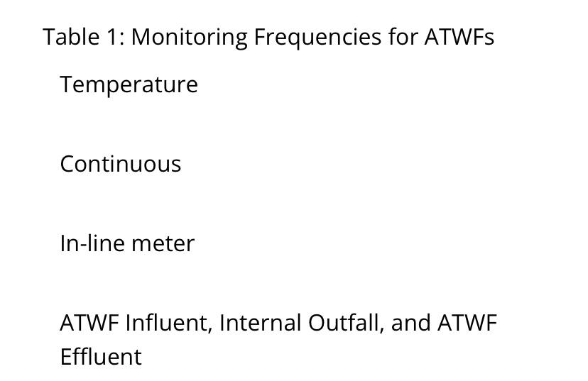

Slide 20
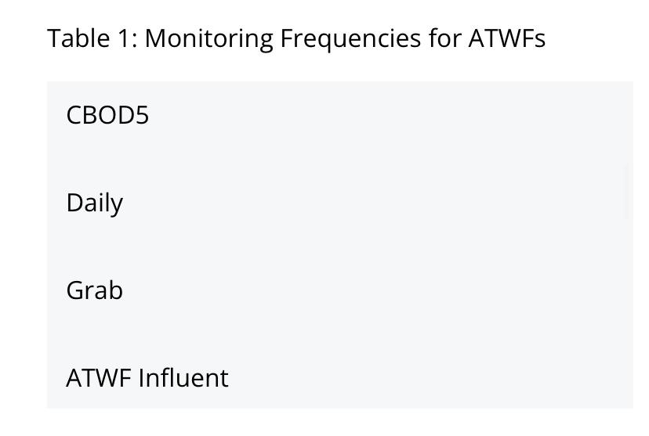
CBOD5 = Carbonaceous Biochemical Oxygen Demand

Slide 21
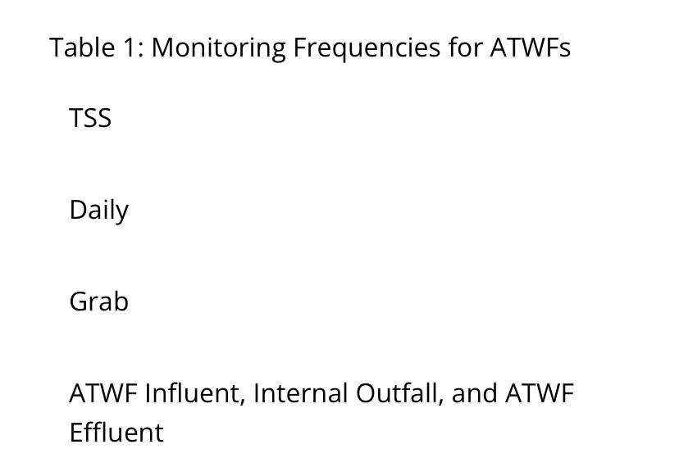
TSS = Total Suspended Solids

Slide 22
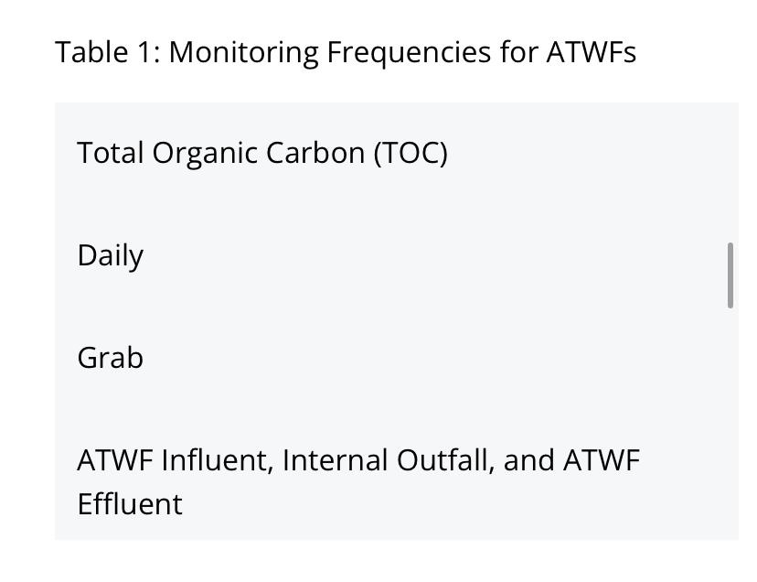

Slide 23
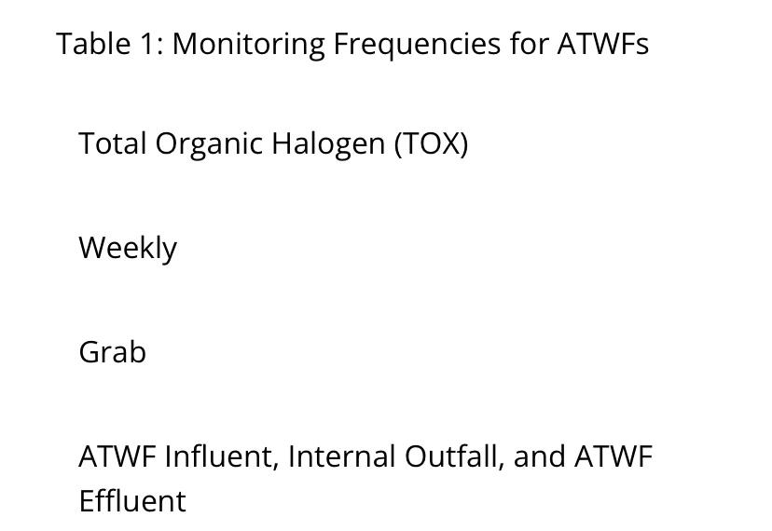

Slide 24
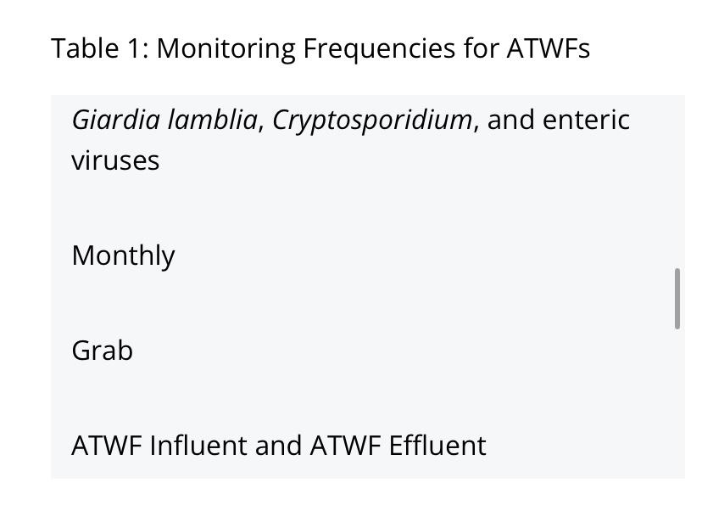

Slide 25
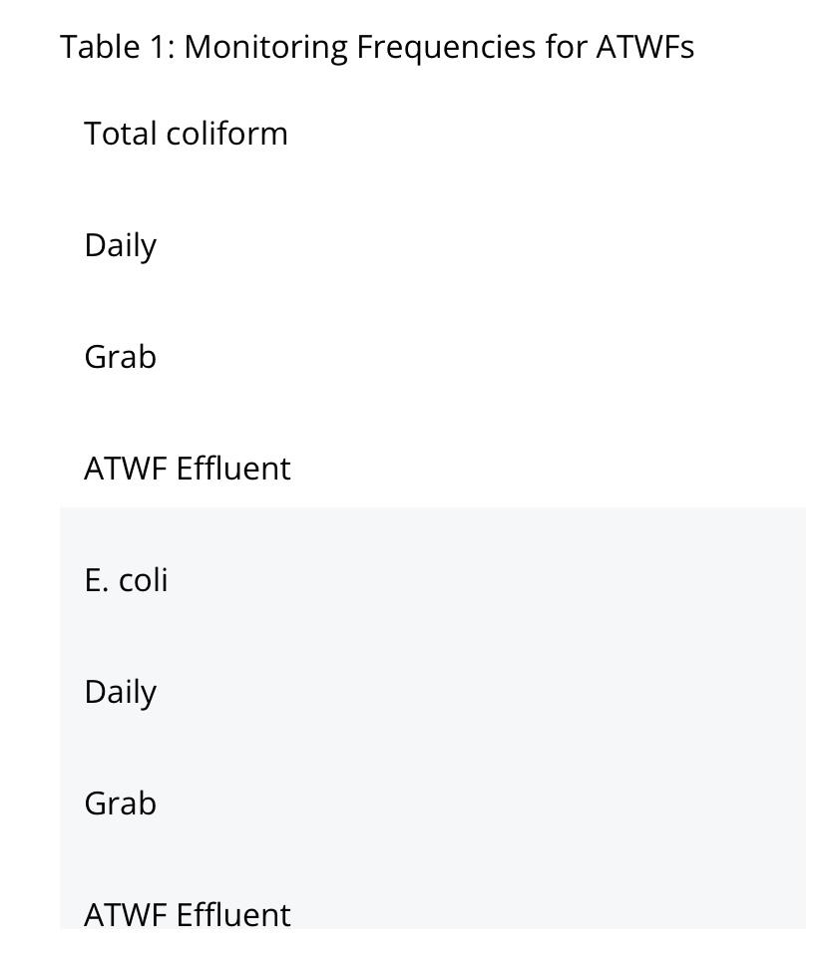

Slide 26
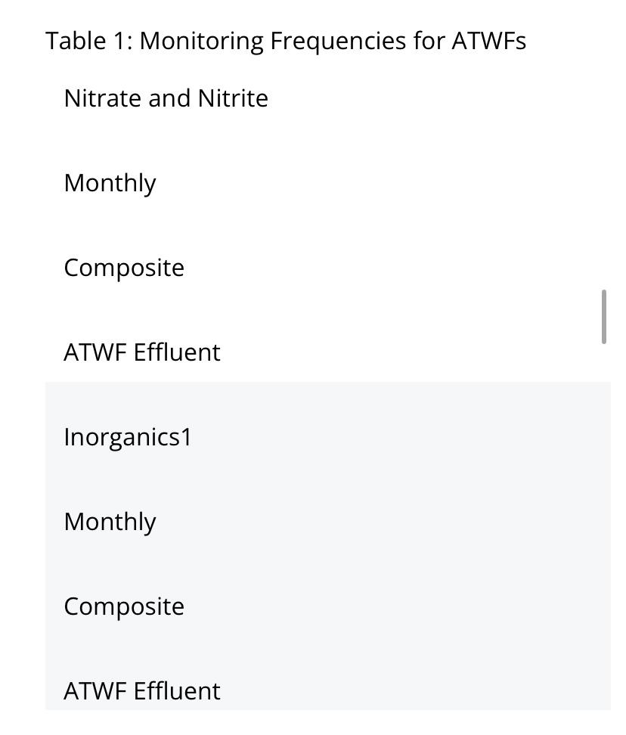

Slide 27
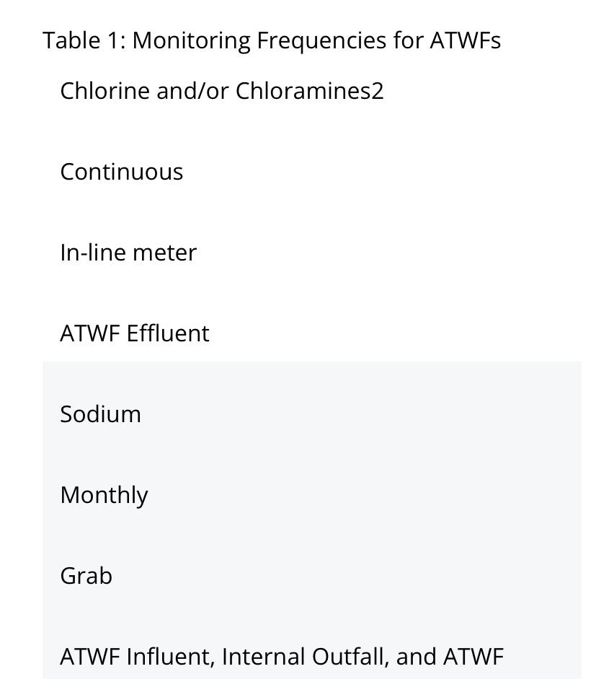

Slide 28
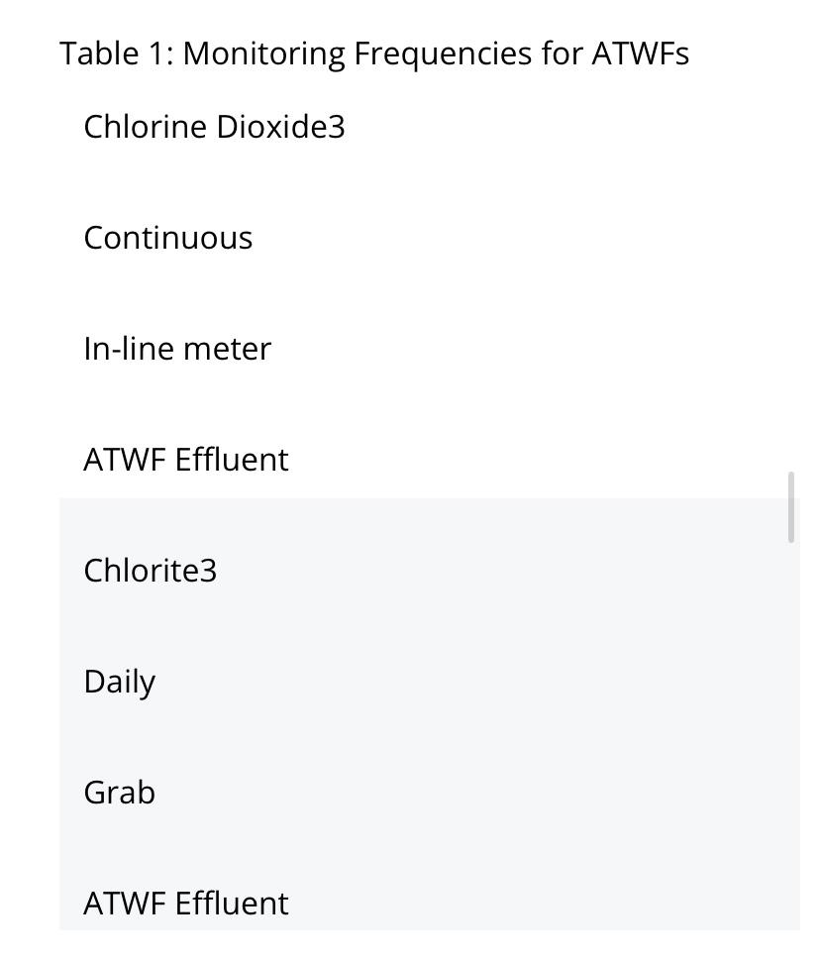

Slide 29
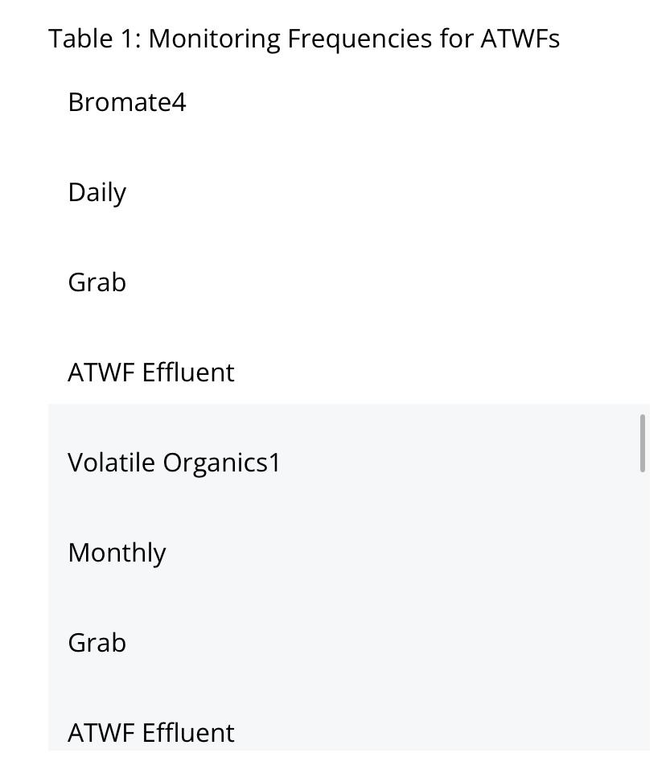

Slide 30
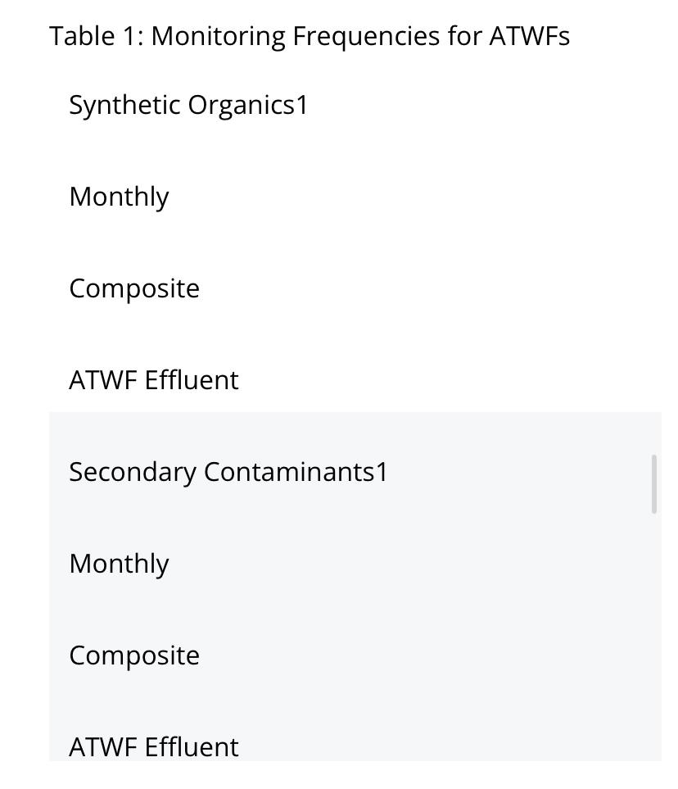

Slide 31
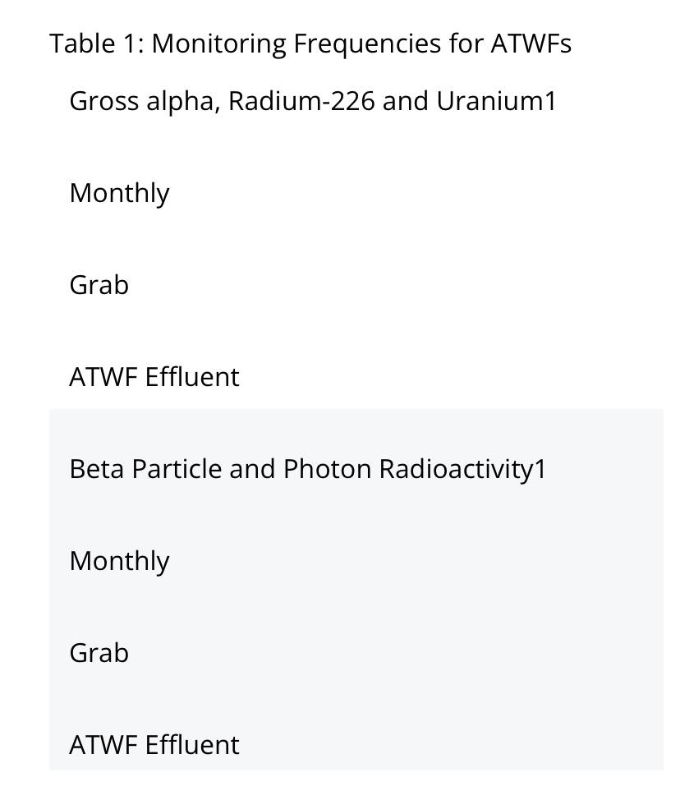

Slide 32
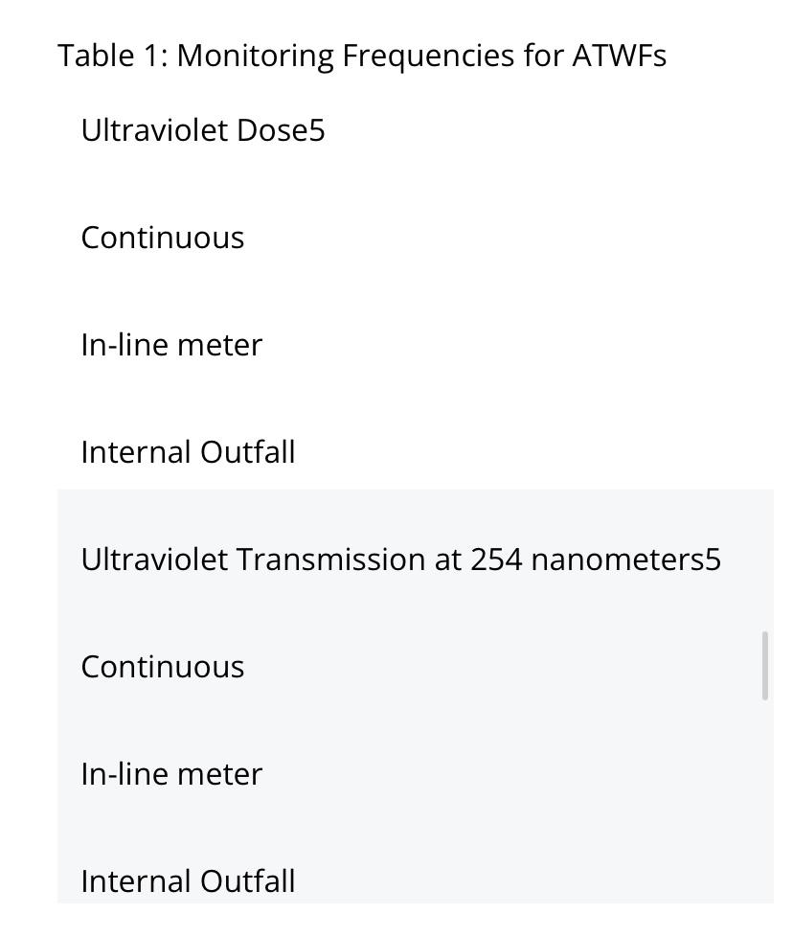

Slide 33
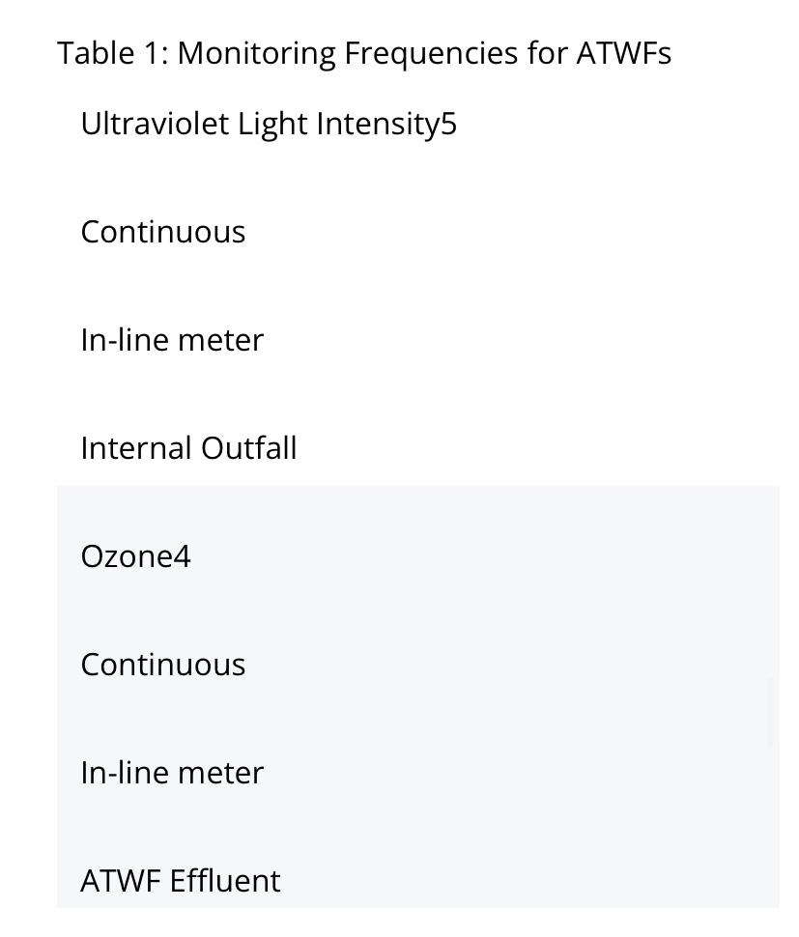

Slide 34
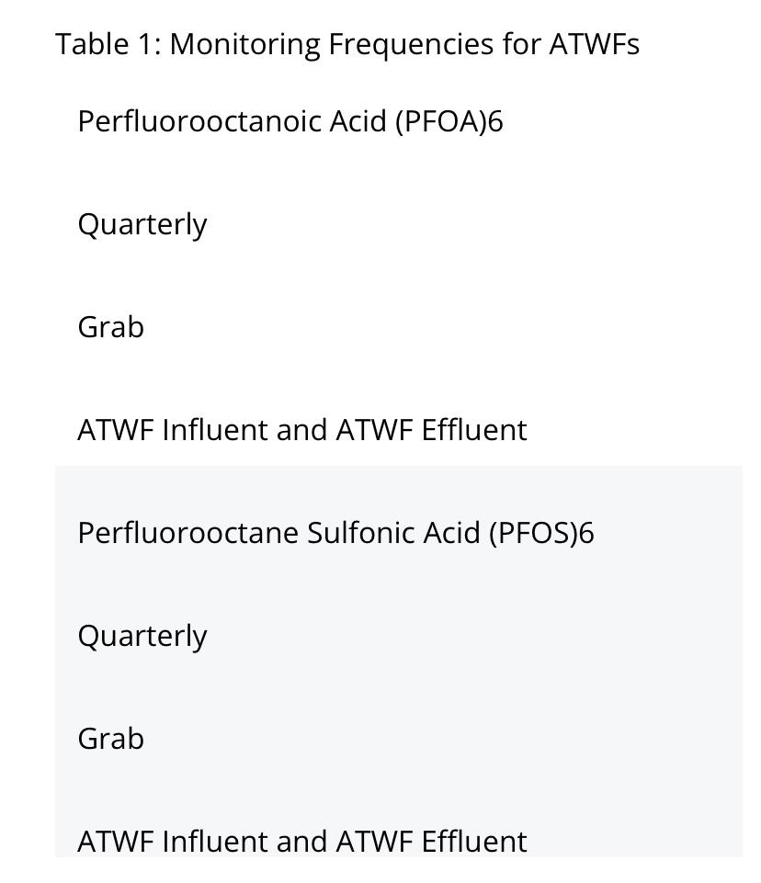

Slide 35
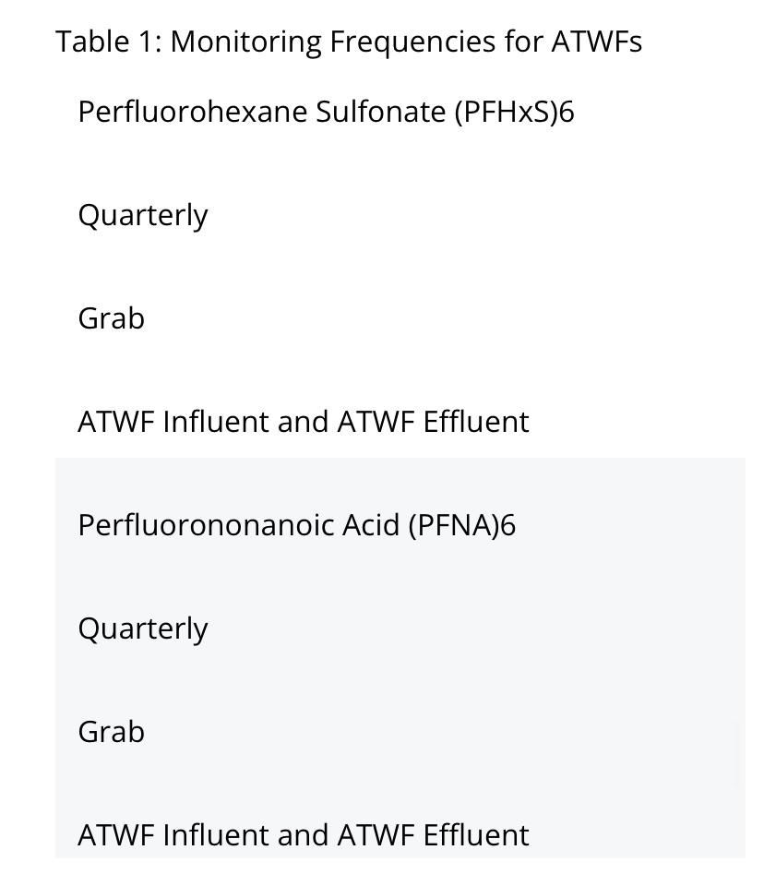

Slide 36
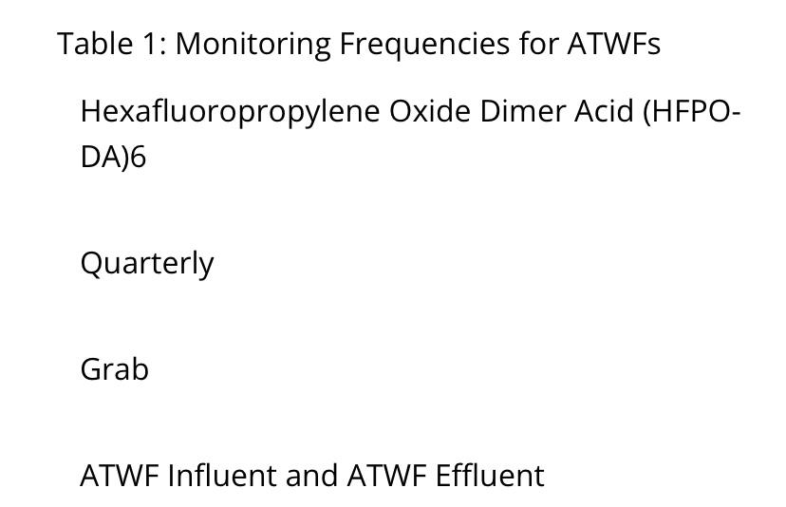

Slide 37
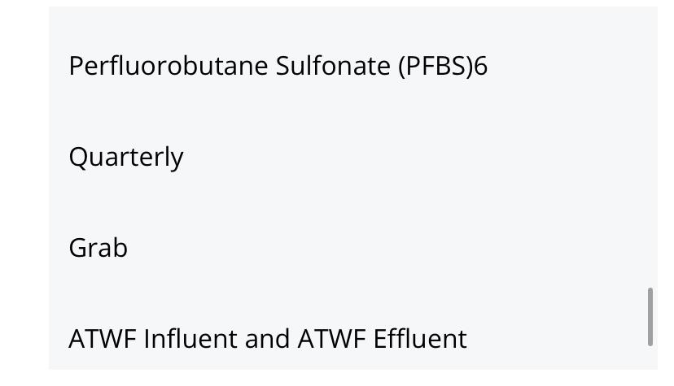

Slide 38
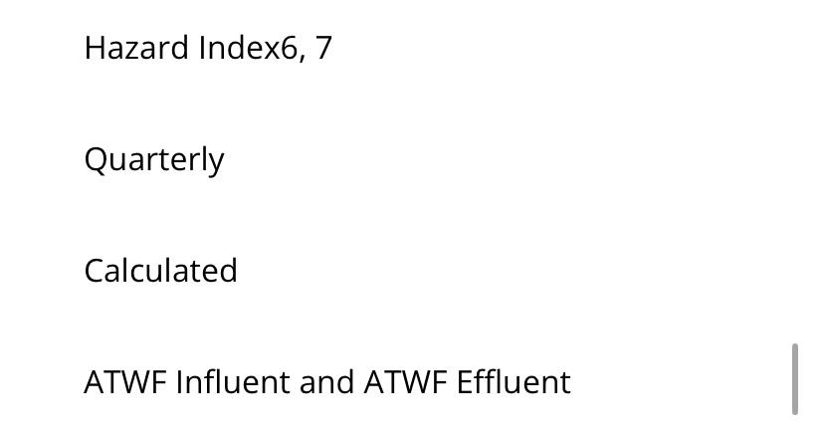

Slide 39
To review some Monitoring Requirements and standards
For giardia and cryptosporidium and enteric viruses if none are detected for two years, the advanced water treatment facility may transition to biannual testing
In addition the advanced treatment water facility shall conduct semi annual sampling of water entering and exiting the advanced water treatment facility for toxic pollutants

Slide 40
Pilot testing is required before implementation of an operational AWTF/ASR Well and pilot testing will use reclaimed water, with a minimum of one year of data prior to implementation.
During testing, projects have to comply with system size requirements, full treatment and disinfection requirements, pathogen reduction requirements, distance requirements, hydraulic loading rate requirements, public notification requirements, and cleared with an expert engineer. It has to be proven that injection is done into a confined aquifer and there is no potable water supply well within 3,500 ft of ASR Well.
Cyber security protocols are required for ASR Use consideration.
Cross connection controls and operation distances are considered.
Requirements include that the treatment train include multiple independent treatment barriers for control of organic compounds and pathogens.

Slide 41
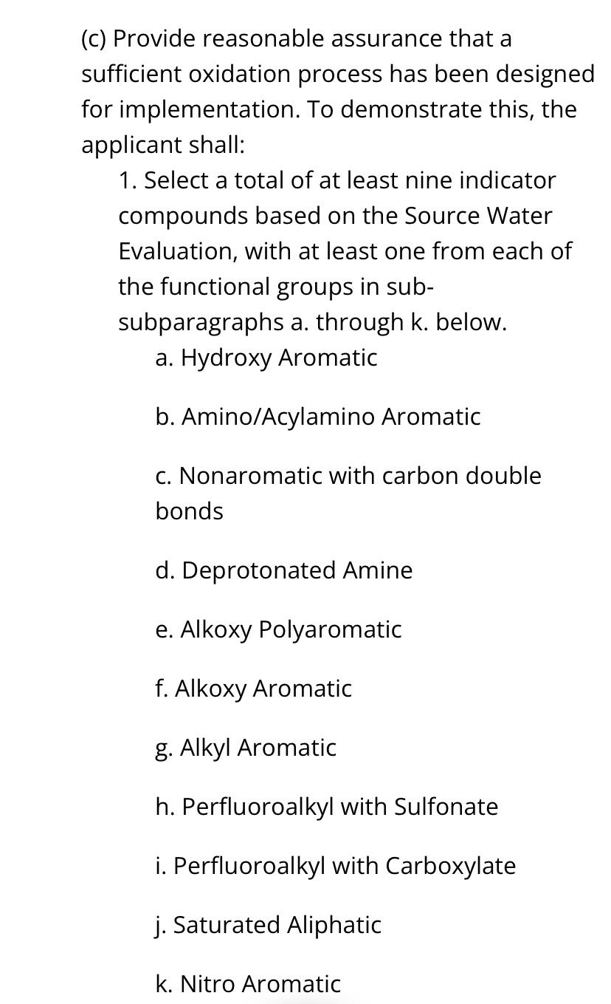

Slide 42
Regarding Operational Monitoring
During full scale operation, oxidation processes are mandated to be continuously monitored
Requirement exists of achieving optimal removal expected chemical emissions from local industry and to have associated alarms if the process is not operating as designed

Slide 43
Regarding the project being cleared with an expert engineer
An "Engineering Report" is necessary to support a permit application for entering a pilot testing phase and the engineering report is colossal.

Slide 44
Some of what an Engineering Report Includes. It includes..
The Cost to construct, a description of existing PWS (or public water system) and wastewater facility and discussion of the impact the project will have on existing facilities.
Includes the Name and location of all water sources entering the ATWF And the design and actual water flows.
Includes the Design capacity of facilities involved, existing type of treatment provided at each, number and capacity of existing finished water pumps.
The Name, location, type, and useful capacity of existing off-spec wastewater facilities and discussion of the impact the project will have on existing facilities. Off-spec is infrastructure that exists but does not currently meet standards.
Engineering report includes the Name, location, type and useful capacity of existing off-spec and finished water storage ponds and tanks.
Requires Documentation that existing potable water wells meet construction requirements.
Includes a Discussion of sanitary hazards within 500 feet of potable water and ASR Wells or those located less than 500ft upstream of surface water intakes.
Includes A description of surface water intake structures, impoundments and reservoirs.

Slide 45
Report includes assessment of effects from indirect potable reuse on ground water and surface water levels, ground and surface water quality and uses of property in the area
Includes documentation of written notice to the public water supply utilities and the appropriate county health department for indirect potable reuse
Includes report of total capacity of all water sources and treatment facilities connected to an ATWF
The findings of source water evaluations
And a discussion of applicable treatment and disinfection technique requirements
It includes a Hazard analysis

Slide 46
Report includes a discussion of critical control points, operational parameters and monitoring points, as well as operation and control strategies
An evaluation of adequacy of ATWF to meet standards given the quality of raw water from all water sources for the plant
A design for daily operations
A flow diagram showing all ATWF operations and processes including residuals handling, chemical application points, water pumping facilities, bypass arrangements and recycle flows
The blending ratio of volume of advanced treated water received by the public water system to the volume of other source waters received at the public water system

Slide 47
A design of the dose for water treatment chemicals
Controls for management of potential chemical peaks for chemical constituents that have the potential to pass through the ATWF
An evaluation of types, quantities, characteristics, and disposal method of residuals generated by the ATWF

Slide 48
Report includes the sizes, capacities, retention times, loading rates, schematic diagrams and other design parameters and details to demonstrate the ATWF (Including chemical application, residuals handling and water pumping) will comply with requirements including proper air gaps between drains, overflows and sanitary or storm sewers
An assurance of compliance with odor control requirements
Assurance that storage tank systems meet performance standards
Assurance optimal housing and safety and protective equipment for new or altered chemical application facilities

Slide 49
Hydraulic analysis for the size of new or altered pipes that convey reclaimed water.
A Site plan including locations of meters, valves, critical control points, monitoring points and blow-offs, interconnections between potable reuse system components, dimensions and elevations of structures.
Appropriate groundwater elevations in relation to subsurface structures.
Documentation pipes and appurtenances (or connections) provide strength, durability, reliability and public health protection.

Slide 50
Of course there is a lead use prohibition.
Mandatory color coding of above ground piping associated with potable reuse system.
A description of electrical systems and provisions for standby power.
Description of operation and control strategies and instrumentation and control systems including monitoring or alarm systems for pumping and storage facilities.
Introduction of reclaimed water to a drinking water treatment facility must have affirmative demonstration that the water meets the requirements of public health protection equivalent in advanced waste treatment.

Slide 51
National Context
There have been 390 projects announced nationwide primarily in the West and Southeast since 2020 for re-use blackwater.
Currently there are 70 ASR Wells using advanced treated blackwater nationwide.
There is 47 billion dollars in planned spending through 2035 nationwide for these projects.
In 2016 FL had the most installed re-use capacity of any state, but since has been over-taken, by states like AZ where re-use blackwater is common.

Slide 52
Finally
The question is not whether the phrase ‘toilet-to-tap’ sounds alarming (it does), the question is whether the science and engineering behind these systems are safe.

